Slide 1
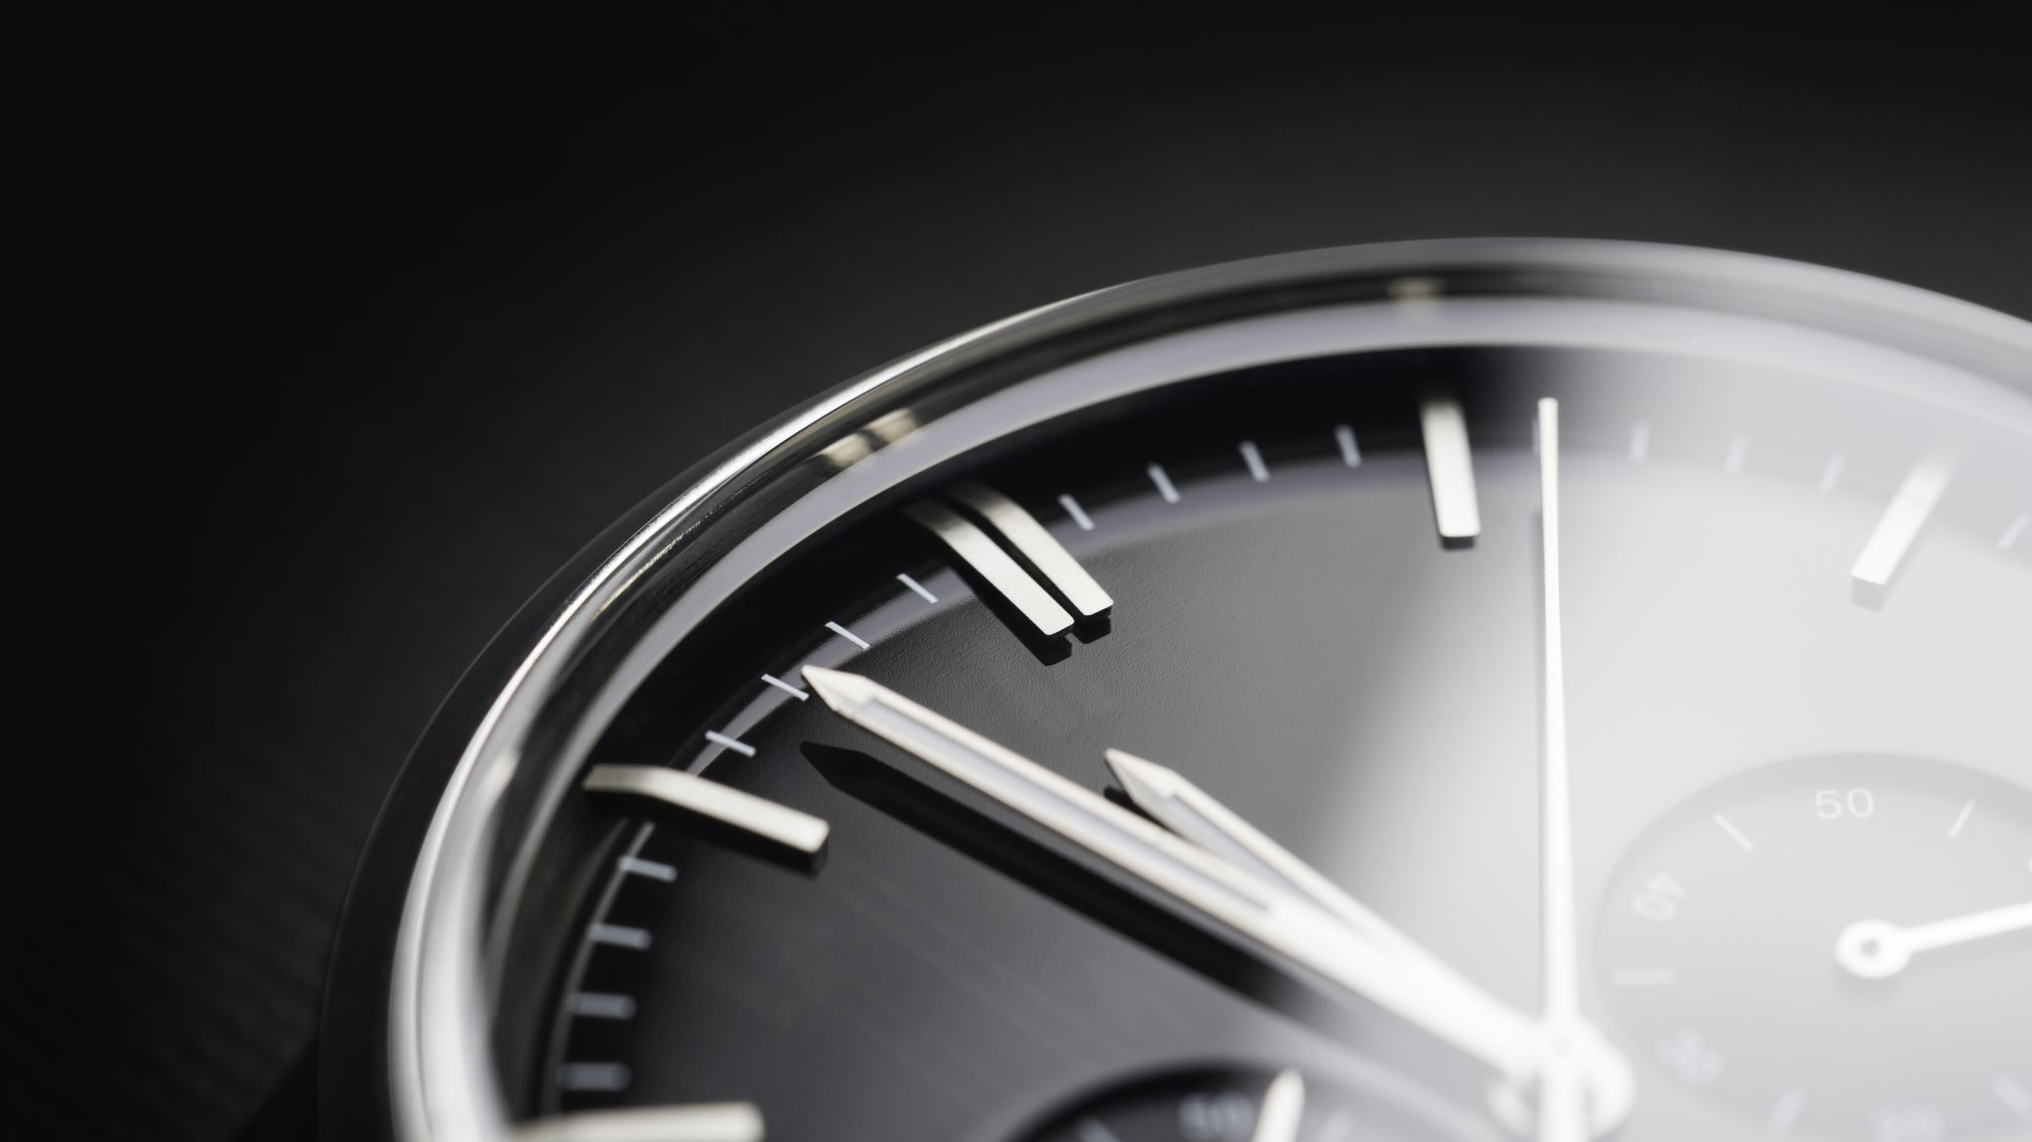
IEESP – LUXURY WATCH
Sean Kelly X00221555| David Burgos X00229142 | Daniel Alonso X00226363

Slide 2
Dataset Acquisition
The dataset in which we have chosen is a luxury watch pricing dataset. The criteria in which this dataset contains includes brands, models, prices, cases, straps, movements, water resistance, case diameter, case thickness, band width, dial color, crystal material, complications and power reserves.
The dataset has 14 columns and 508 rows. It is a publicly available dataset available on Kaggle. https://www.kaggle.com/datasets/rkiattisak/luxury-watches-price-dataset/data
This dataset is useful for Businesses, Resellers, enthusiasts and individuals wishing to further expand their knowledge in the expertise

Slide 3
Objective
The Objective of this project is to evaluate and provide statistics on the pricing of these watches compared to the prestige of their branding and the condition they are in. We believe that these categories are important to compare as branding significantly influences the perceived value and resale potential of a luxury watch, aswell as the condition greatly affecting the collectability aswell as longevity of the singular watch itself.
Our Solution can be used to understand the pricing compared to the watch quality generally. Another way to do this would be to visit an actual jewellery shop although this could involve bias based on the products they have available. Some limitations we faced include the lack of some aspects in the dataset, age, retail vs resell and availability

Slide 4

AI System
We plan to demo the AI user system by asking the user to input Brand, User Lifestyle and Price. With the information given, the system will take the information from the dataset and inform the user whether the watch seems like a good option for the price quoted compared to the user's lifestyle, aswell as how reliable the watch should be.

Slide 5
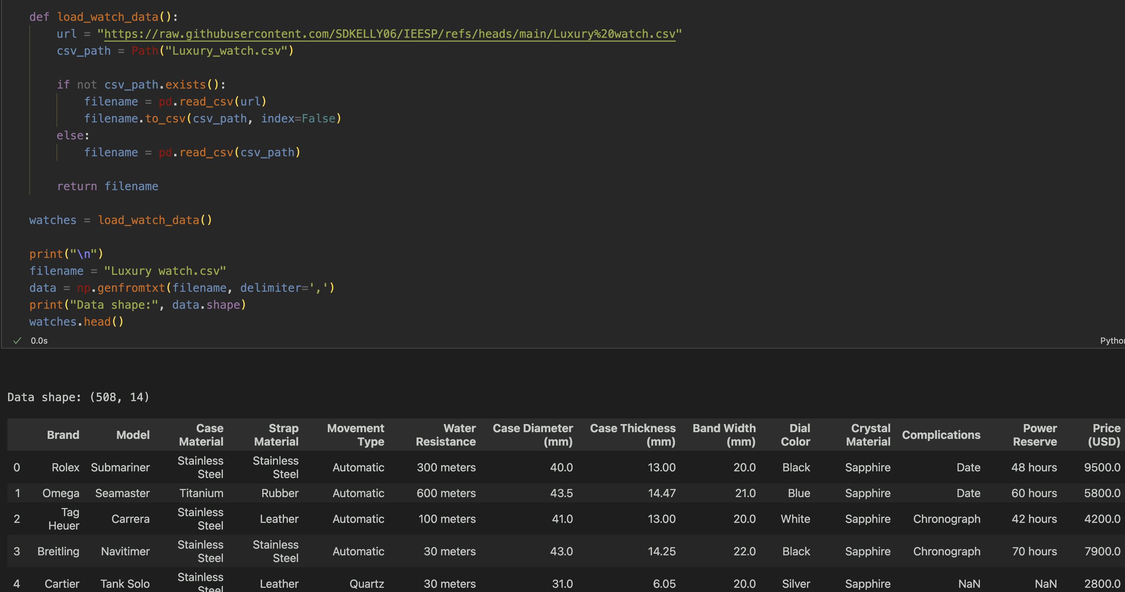
Data shape and table

Slide 6
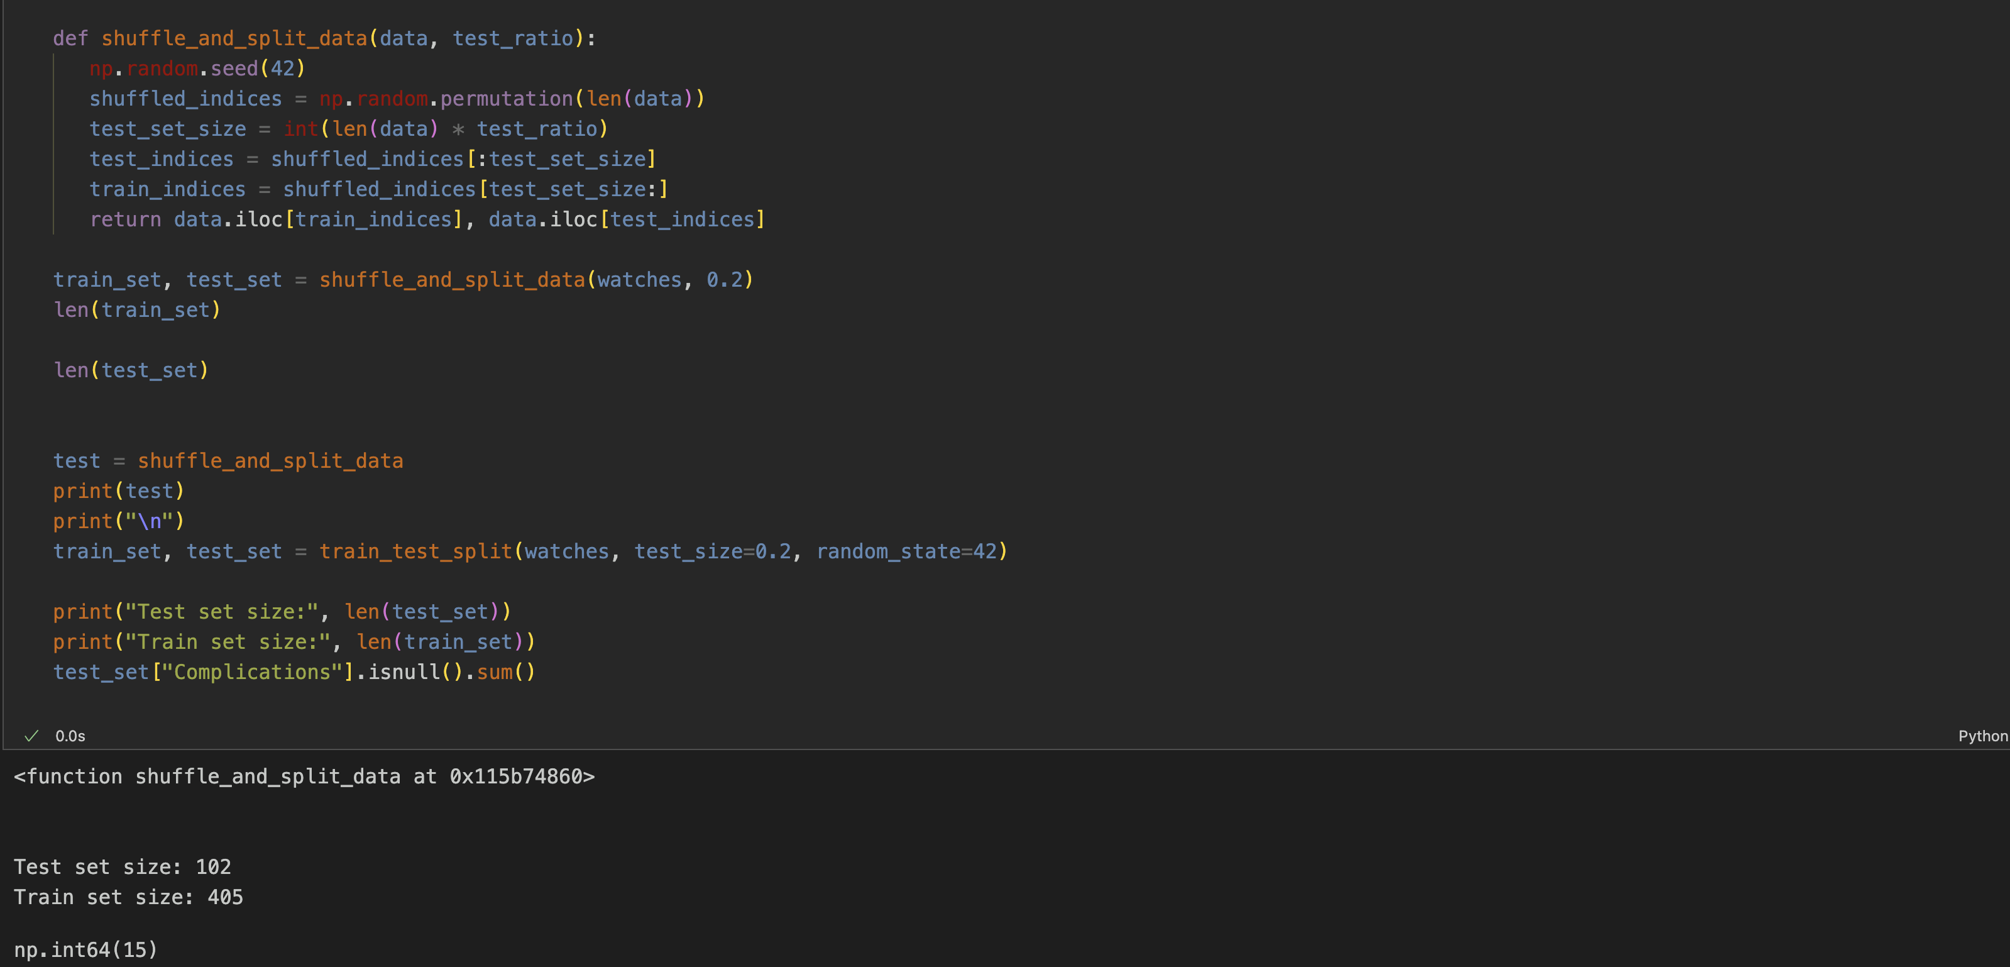
Test Set Creation

Slide 7
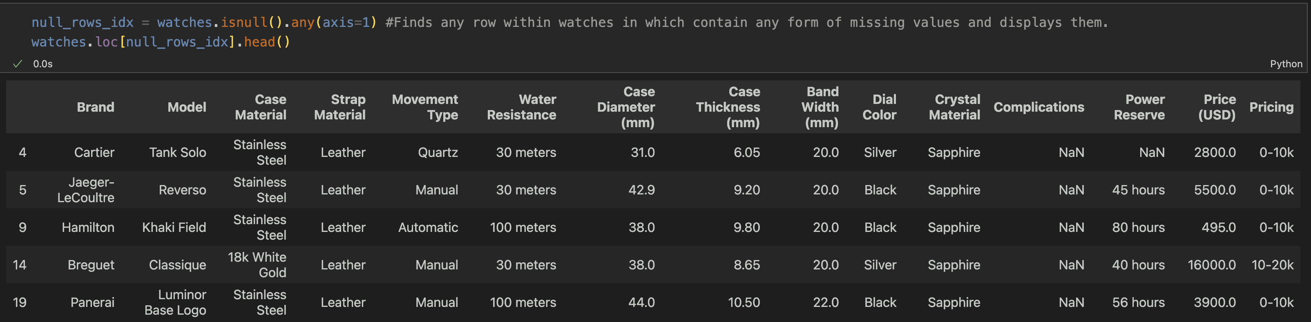
Missing Values

Slide 8
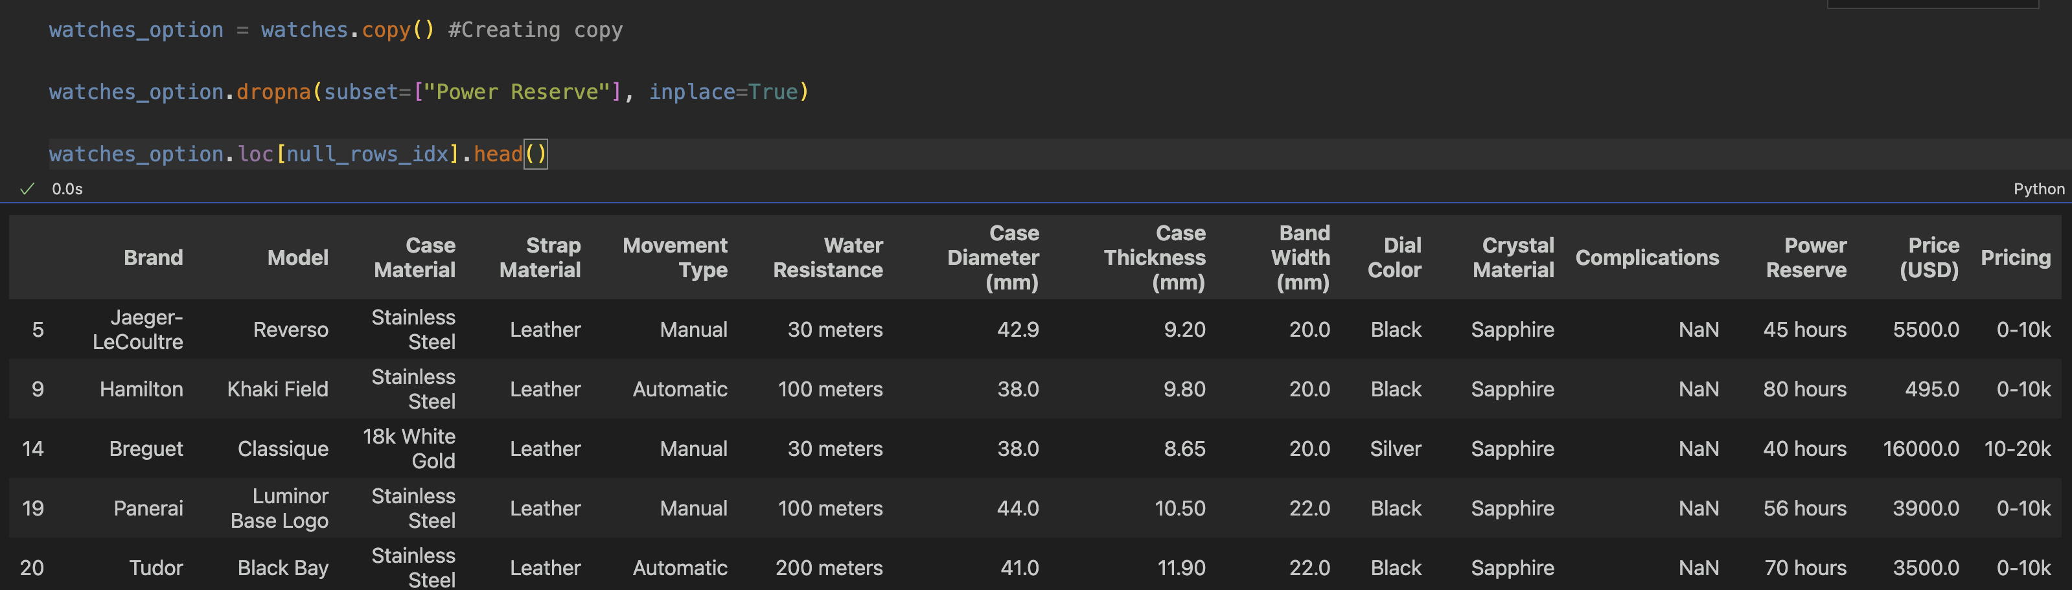
Copying Dataset

Slide 9
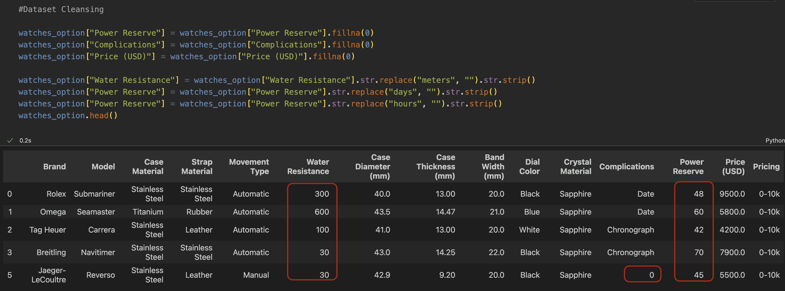
Dataset Cleaning

Slide 10
Feature Selection and Pre-Processing
The Features we have decided are most important to take into consideration are Brand and Prices (USD). Branding is a huge consideration in pricing especially in the watch industry and so we believe this correlation is most important. These are Found in the 1st and 13th column.

Slide 11
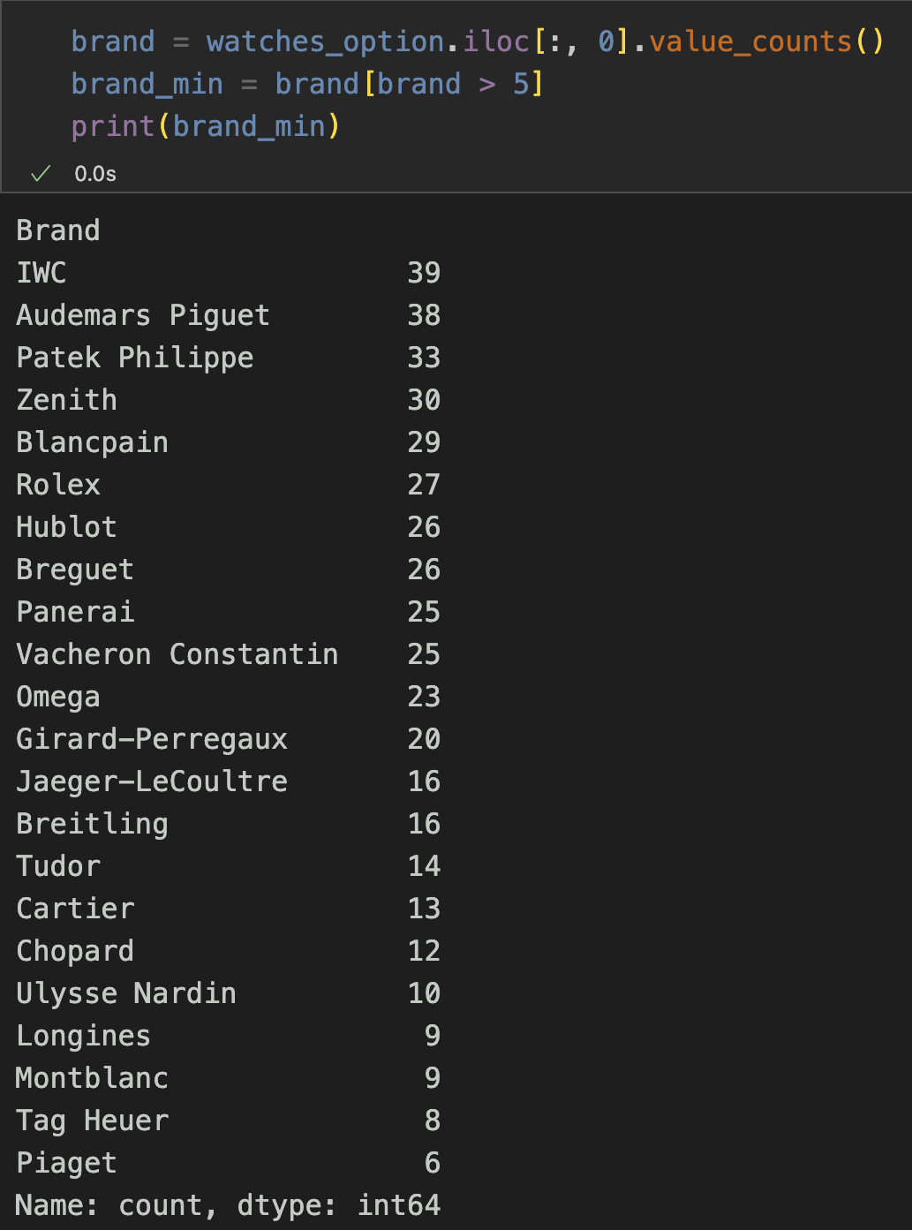
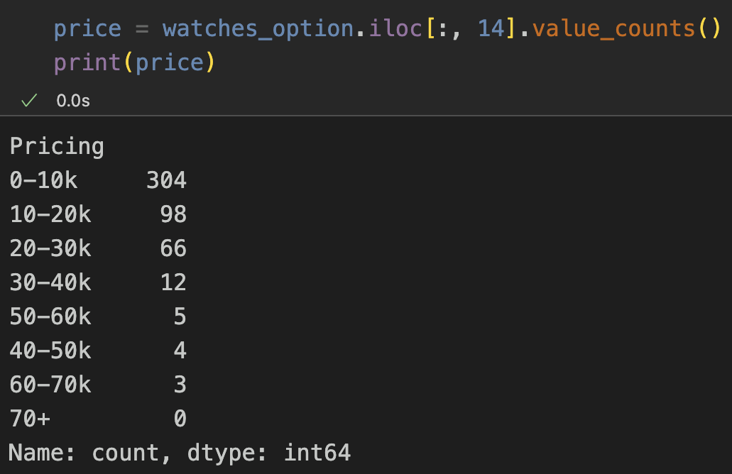
Feature Selection

Slide 12
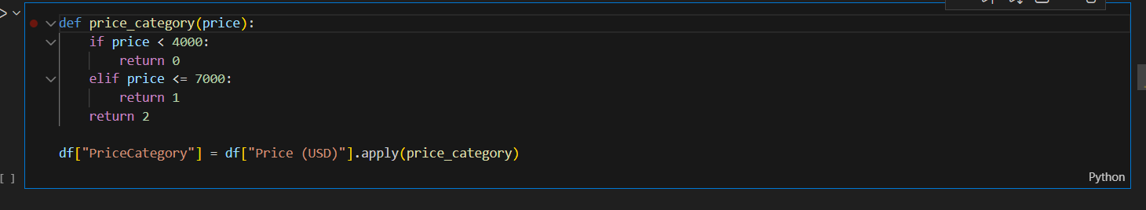
Models Training
To keep the price precise, we classify the watches in terms of the price with a simple function. It will also allow us to train classification models.

Slide 13
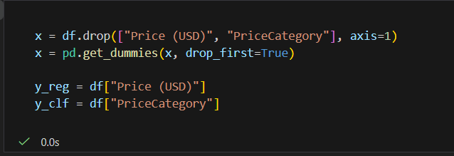
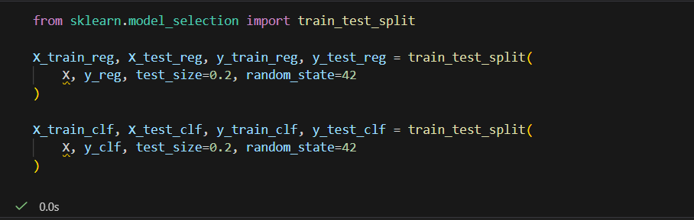
Models Training
These variables are used to train the models, where x contains all the watches' characteristics, such as the price, and y is the variable used for predicting the price and the category.

Slide 14
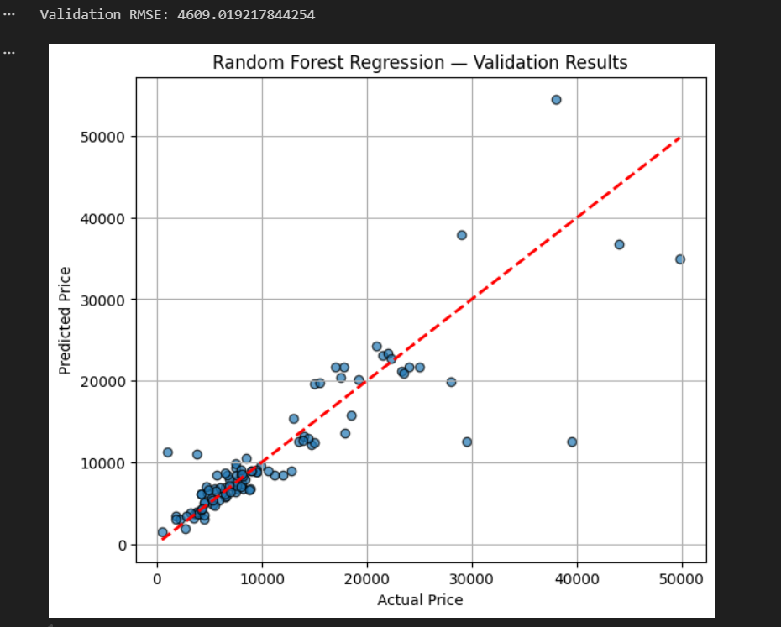
Random Forest
We use random forest to predict the watches' price. This model builds decision trees on random subsets of the data.

Slide 15
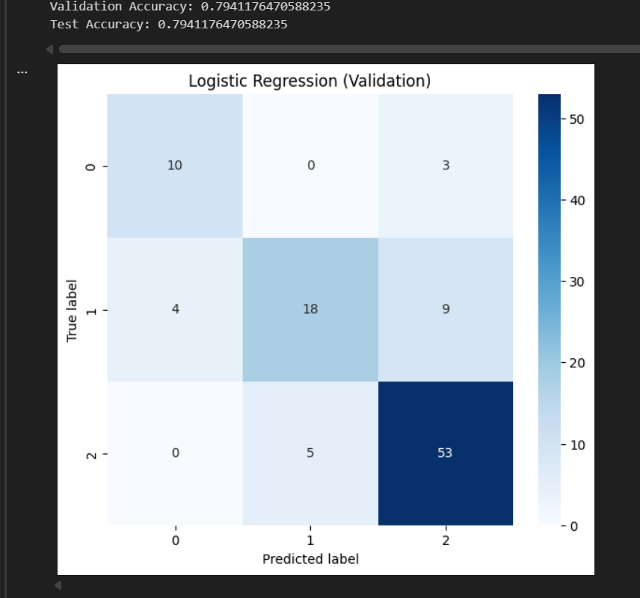
Logistic Regression
The Logistic Regression is a linear model for binary classification that estimates probabilities. Outputs probabilities and let us know how it classifies each category.

Slide 16
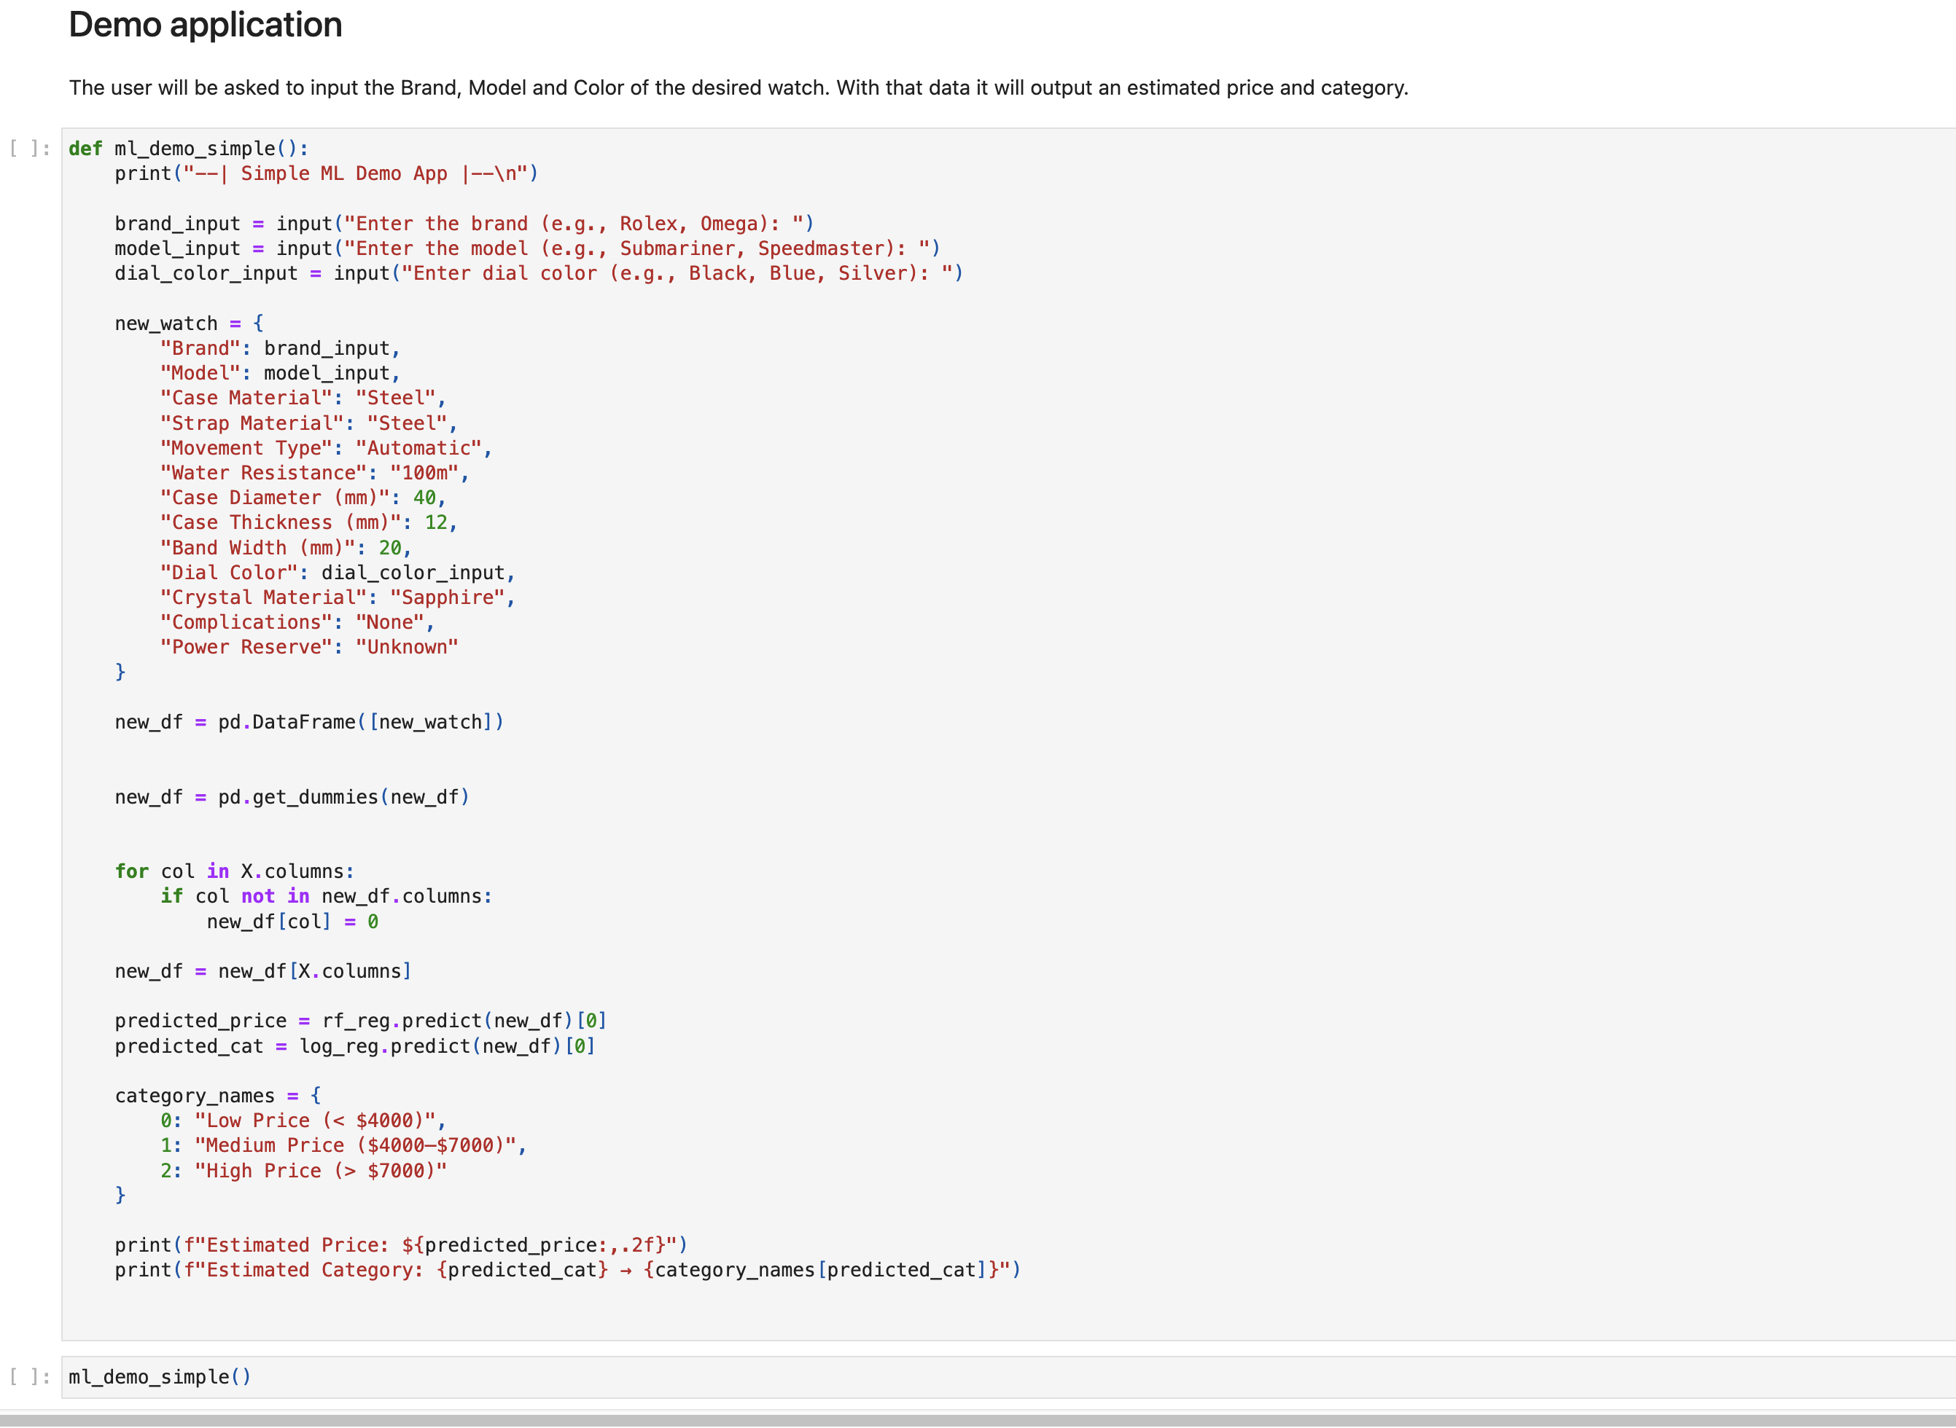
Demo Application
Demo moved to HTML file as too big to show within a jupyter notebook

Slide 17
Limitations
Some of the limitations we discovered while completing this project included:
The Strings within the dataset
Missing Categories (Age, Availability, Retail vs Resell)
Size of the Dataset

Slide 18
Reflection
Reflecting on our work, we believe:
We could develop on the current project to be more specific (Age, Retail vs Resell, Availability)
We learned more about Data Cleaning, Copies of datasets and Model Development
We now understand the importance of communication and teamwork while working with AI applications.
We could have inspected the workload before selecting a dataset(Relatively small)

Slide 19
Contribution
Seán | Dani | David
Presentation | Model Development | Dataset Selection
Test set & Data Cleaning | Feature Selection | Model Development
Feature Selection & Visualizing Data | Data Loading | Random Forest & Logistic Regression

